Slide 1
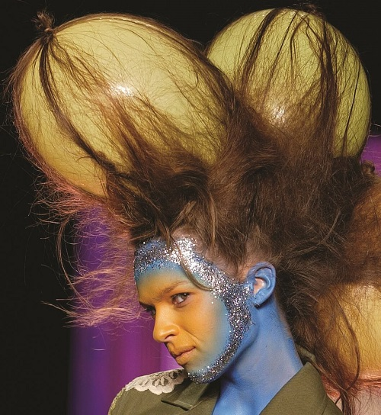


Part I Warm Up
Fashion
Answer these questions with a partner.
Look at the photo. Do you like this style?
Answers will vary.
What are three fashionable cities around the world?
Possible answer: London, New York, Tokyo.
How many colors and items of clothing can you name? Make two lists.
Colors: red, orange, yellow, green, blue, purple, black, white, brown, gray, pink, turquoise, tan, etc.
Items of clothing: hat, scarf, shirt, blouse, T-shirt, sweatshirt, sweater, coat, jacket, pants (trousers), shorts, skirt, dress, shoes, boots, etc.
Items of clothing: hat, scarf, shirt ,
Items of clothing: hat, scarf, shirt , blouse, T-shirt, sweatshirt, sweater, coat,
Items of clothing: hat, scarf, shirt , blouse, T-shirt, sweatshirt, sweater, coat, jacket, pants (trousers), shorts, skirt , dress, shoes, boots, etc .
Colors: red, orange, yellow, green, blue, purple, black, white, brown, gray, pink, turquoise, tan, etc .
A model at a British fashion show

Slide 2
Content Note
In a fashion show designers give an artistic presentation of their high-end lines of clothing. Fashion shows are meant to be entertaining and are expected to be a type of art exhibition. The designer’s style and sense of fashion is being presented as much as the clothes, which is why the models’ hair design and makeup are also often extreme and eye-catching.
Note that the more extreme clothes showcased in a fashion show are usually not found in regular stores,but instead are considered to be couture, representing the most expensive and highest end versions of that designer’s current line of clothing. For example, there might be only one version of a very high-end dress available for that season. A designer’s ready-to-wear line includes the clothes that are mass-produced for the general public. These clothes can be bought in stores.

Slide 3
Language Note
The term fashion usually refers to what is popular at that moment in clothing styles. Fashion designers make designs and clothes. Fashion magazines share the latest fashion trends with readers. Most people have a certain fashion sense, which means they like to wear one type of style and buy clothes in that style. Some examples of styles include: preppy, sporty, edgy, hip hop, punk, boho, casual, formal, professional.

